Slide 1
Role-Playing: Child Soldier Rehabilitation Team
Along with other classmates, you’re going to work as a United Nations Children’s Fund (UNICEF) Team to gather a group of experts who will help child soldiers like Ishmael Beah who have been taken off the battlefield to cope with their experiences in war—mentally, physically, spiritually, and emotionally.
Problem: You have a limited budget. The United Nations has allocated only enough money for you to hire a team of four experts in various fields who will rehabilitate help child soldiers so they can reintegrate into society or be repatriated somewhere else.
Your Goal: Gather the best team of four experts from the following list.
Keep in mind what you learned from reading A Long Way Gone, particularly the mental, physical, emotional, and spiritual state of child soldiers like Ishmael when they are taken from the battlefield
How to Report: On the space provided, write the individual names and salaries for the people you’ve chosen. Then, for each, explain why you chose that person, using information from A Long Way Gone as supporting detail.
First…review the list by yourself, and decide what qualifications you’d like to see in the people you choose. Then, we’ll work in groups.

Slide 2
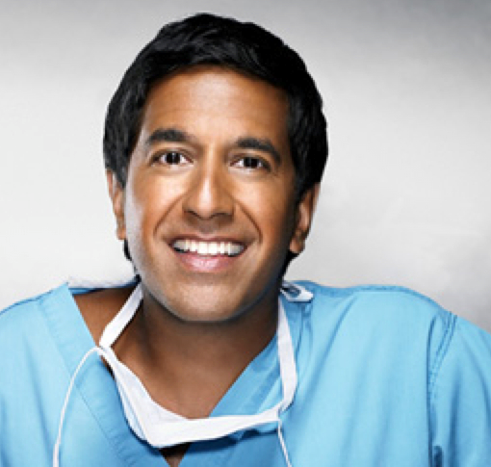
Expert #1
Qualifications
Dr. Ravi Ramasary
Child Psychologist: Trained at the University of Cincinnati to work with children who have been abused.
Specialty: Helping children who have been victims of violence to cope with their suffering
Personal: Raised in India and the United States; traveled to Africa throughout college. Has no wife or children; has suffered from clinical depression.

Slide 3
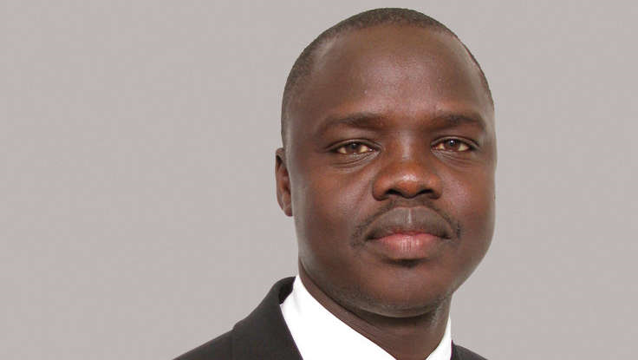
Expert #2
Qualifications
Valentino Achak Deng
Speaker / Writer: After living as a refugee from the Sudanese civil war for 14 years, Valentino was relocated to the U.S., where he went to college, spoke to churches and schools about issues dealing with child soldiers, and wrote a bestselling book about his experience.
Specialty: Valentino works with former child soldiers and refugees to help them find their voices in sharing their stories.
Personal: Has an adopted family in the United States; travels monthly to his hometown in Sudan, where he coordinates a rebuilding effort to construct a school and homes.

Slide 4
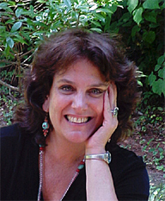
Expert #3
Qualifications
Chandra Ellis, Ph.D
Oral Historian/Storyteller: Dr. Ellis has a doctorate in African literature, particularly the oral tradition/stories of over 40 African countries.
Specialty: Besides teaching at New York University, Dr. Ellis facilitates workshops with tribal chiefs in Africa and children in America (particularly in urban populations) in order to help them tell their own stories in more compelling ways.
Personal: Dr. Ellis has adopted two refugees from Rwanda.

Slide 5
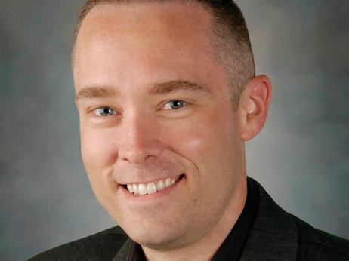
Expert #4
Qualifications
Dr. Craig Bryan
Former Army Psychologist: Trained at Quantico Military Hospital; served a tour of duty in Vietnam.
Specialty: Helping veterans who suffer from Post-Traumatic Stress Disorder (PTSD)
Personal: Widower (wife died in tour of duty in Desert Storm); father of adult son who died in Afghanistan as Army Medic.

Slide 6
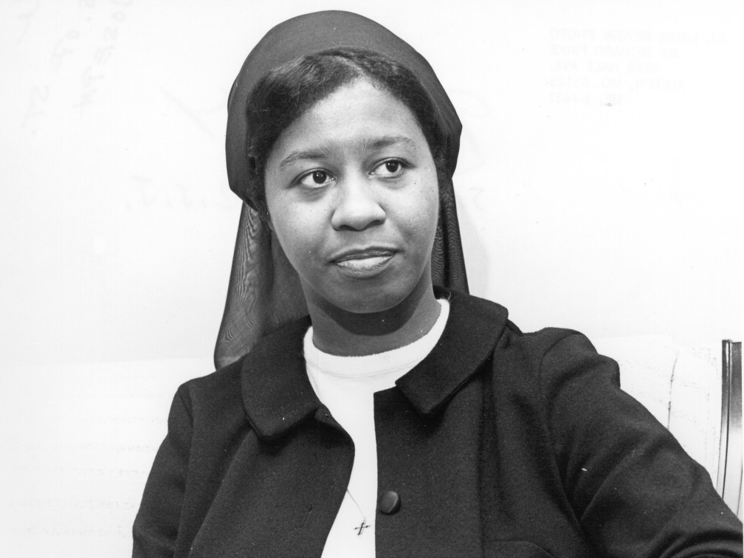
Expert #5
Qualifications
Sister Immaculee Grace
Sister of Charity: Has worked with orphans in Nairobi, Kenya and in refugee camps throughout Africa, particularly in schools.
Specialty: Sister Grace has taught students in K-12 and has a Ph.D. in education from Boston College University.
Personal: Sister Grace has been reprimanded for speaking out against her order’s lack of political action in African nations, and has almost been banished from the Sisters of Charity. Fiercely independent, Sister Grace tends to work alone on projects.

Slide 7
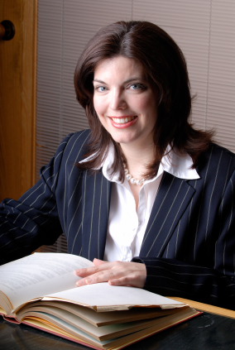
Expert #6
Qualifications
Emilie Russo, J.D.
Lawyer: Has worked with immigration issues throughout her entire 25-year career.
Specialty: Adoptions and relocating refugees to foster parents in their home countries or the U.S.
Personal: With a heavy caseload in the United States, Ms. Russo can only work from America via telephone and email, and won’t be able to meet face-to-face with the former child soldiers besides two three-day-long meetings throughout the course of one year.

Slide 8
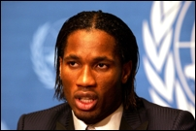
Expert #7
Qualifications
Didier Drogba
Soccer Player & Ambassador: Considered the greatest soccer player in Ivory Coast and one of the best in African history, Drogba also works as a United Nations Development Program ambassador to other African nations.
Specialty: Drogba leads a team of African and European soccer players who run soccer-skills camps for refugees and orphans around war-torn African nations.
Personal: A busy athlete who plays on a European team (as well as his national team), Drogba is only available throughout the year for a one-week period to run the soccer camp.

Slide 9
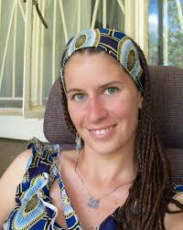
Expert #8
Dr. Beth Lownik
Qualifications
Medical Doctor: Works as a pediatrician (child doctor) in Milwaukee, Wisconsin.
Specialty: Public Health (starting public initiatives to improve overall health of a community) and Pediatrics
Personal: Worked in the Peace Corps in the Dominican Republic in college; has spent every summer since medical school traveling to Uganda to run a women’s health clinic.

Slide 10
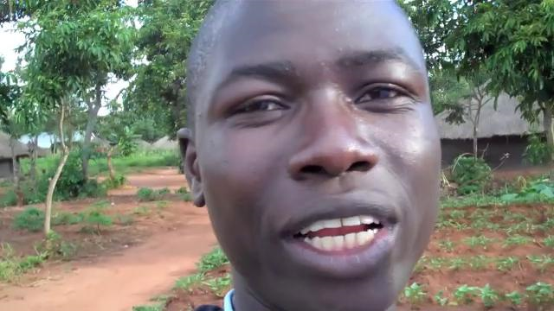
Expert #9
Innocent Aponye
Qualifications
Speaker / Grant Writer: Works with Unified for Unifat to educate Americans about issues dealing with child soldiers. Also writes grants for funds for initiatives.
Specialty: Innocent works with American and European aid workers to find funding to keep refugees in their home countries so they can retain their native culture by going to school and living with African foster parents.
Personal: A former child soldier from Uganda, Innocent has lost his whole biological family, and thus considers the Americans in Unified for Unifat to be his closest “family.”

Slide 11
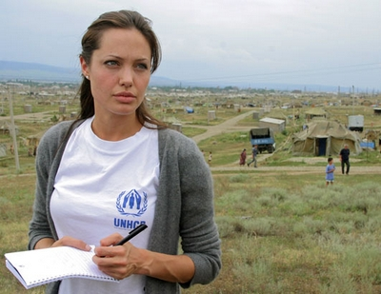
Expert #10
Angelina Jolie
Qualifications
Actress / United Nations Ambassador: Besides being in many blockbuster films, Ms. Jolie works as a Goodwill Ambassador for the United Nations High Commissioner for Refugees
Specialty: Ms. Jolie contributes to the vital process of finding solutions for people displaced by conflict, specifically refugees, by working on the governmental level.
Personal: Married mother of 6 (3 biological, 3 adopted children), Ms. Jolie still lives a busy acting in and directing films, but tirelessly devotes her time to refugees.

